Slide 1

The slides in this PP start off with the screenshot of a section on the myCircadianClock website.
- Below the screenshot is my recommended changes for the section in blood red.
- The * indicates a comment or question directed at you.
General notes:
myCircadianClock should be trade marked
All pics are clip art so need to be redone

Slide 2
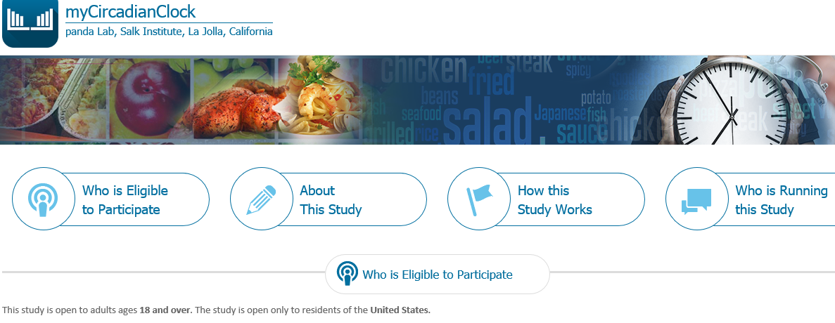
“This study is open to adults ages 18 and over residing in the United States."
*Unless you are talking about US citizenship status.

Slide 3
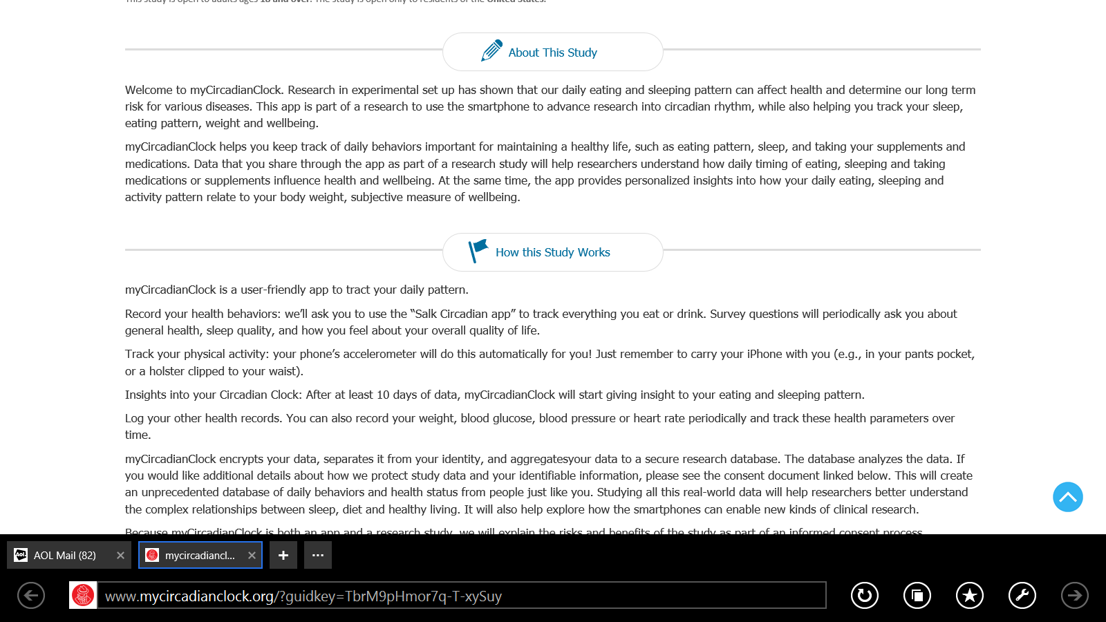
Welcome to myCircadianClock! Research has shown that our daily eating and sleeping pattern can affect health and determine long term risk of various diseases. The myCircadianClock app is part of a research study examining circadian rhythm, while also helping you track your sleep, eating pattern, weight and wellbeing.*”
myCircadianClock helps you track and monitor daily behaviors necessary for maintaining a healthy lifestyle, such as eating pattern, sleep, physical activity and tracking supplements or medications. It will also provide you personalized insight into how these behaviors, in addition to activity pattern, relate to your body weight, a subjective measure of health. Behaviors shared through myCircadianClock will aid researchers to better understand how daily timing of eating, sleeping, physical activity and taking supplements or mediations may influence health and wellbeing.
*I will have to look at the consent but don’t remember wellbeing being a measured measure.

Slide 4
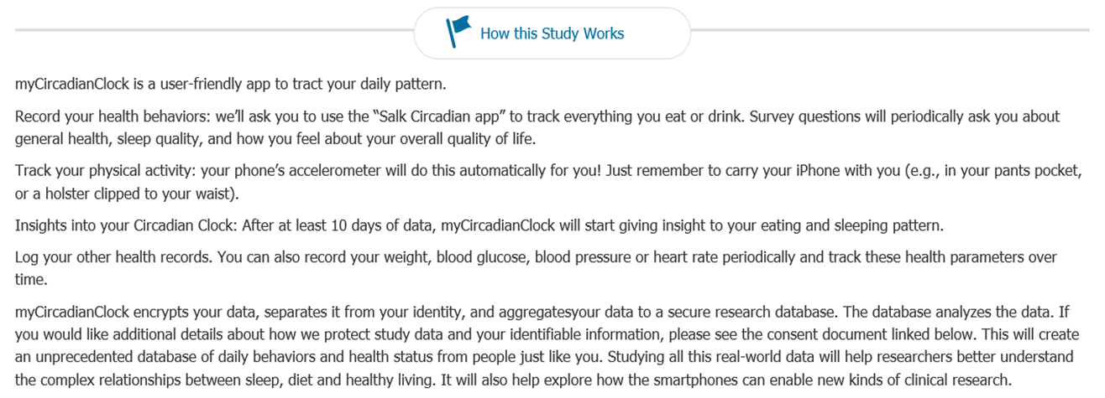
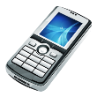

myCircadianClock is a user-friendly app to tract your daily pattern.
You will be required*/asked* to record your health behaviors:
Use the myCircadianClock app to track everything you eat , drink and any supplements or medications.
Survey questions will periodically ask you about general health, sleep quality, and how you feel about your overall quality of life.
You can log the physical activity you do – walking, running, biking, swimming or intense exercise.
Insights into your Circadian Clock: After at least 10 days of data, myCircadianClock will start giving insight to your eating and sleeping pattern.
Log other health data. You can record your weight, blood glucose, or blood pressure periodically and track these health parameters over time.
myCircadianClock encrypts your data, separates it from your identity, and aggregates your data to a secure research database. The database analyzes the data. If you would like additional details about how we protect study data and your identifiable information, please see the consent document linked below. This will create an unprecedented database of daily behaviors and health status from people just like you. Studying all this real-world data will help researchers better understand the complex relationships between sleep, diet and healthy living. It will also help explore how the smartphones can enable new kinds of clinical research.*
*Required or asked – depending on how much you want to stress adherence right at the beginning (Required) or be nice (Asked).
*The strikethrough data has already been stated in previous section and does not address the workings of the study only about the study (previous section).

Slide 5
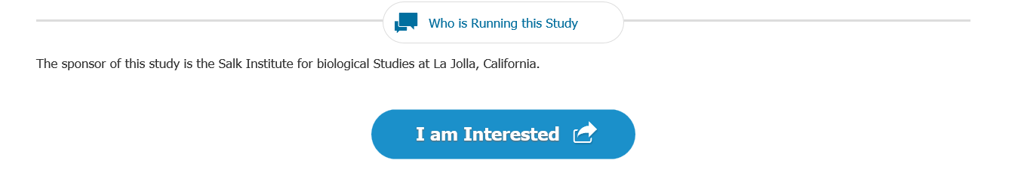
Who is Sponsoring this Study
I am ready to do this! - Tell me More - Am I Eligible *
*Last 3 just different options for target audiences. I can come up with lots, so let me know if you want more.

Slide 6
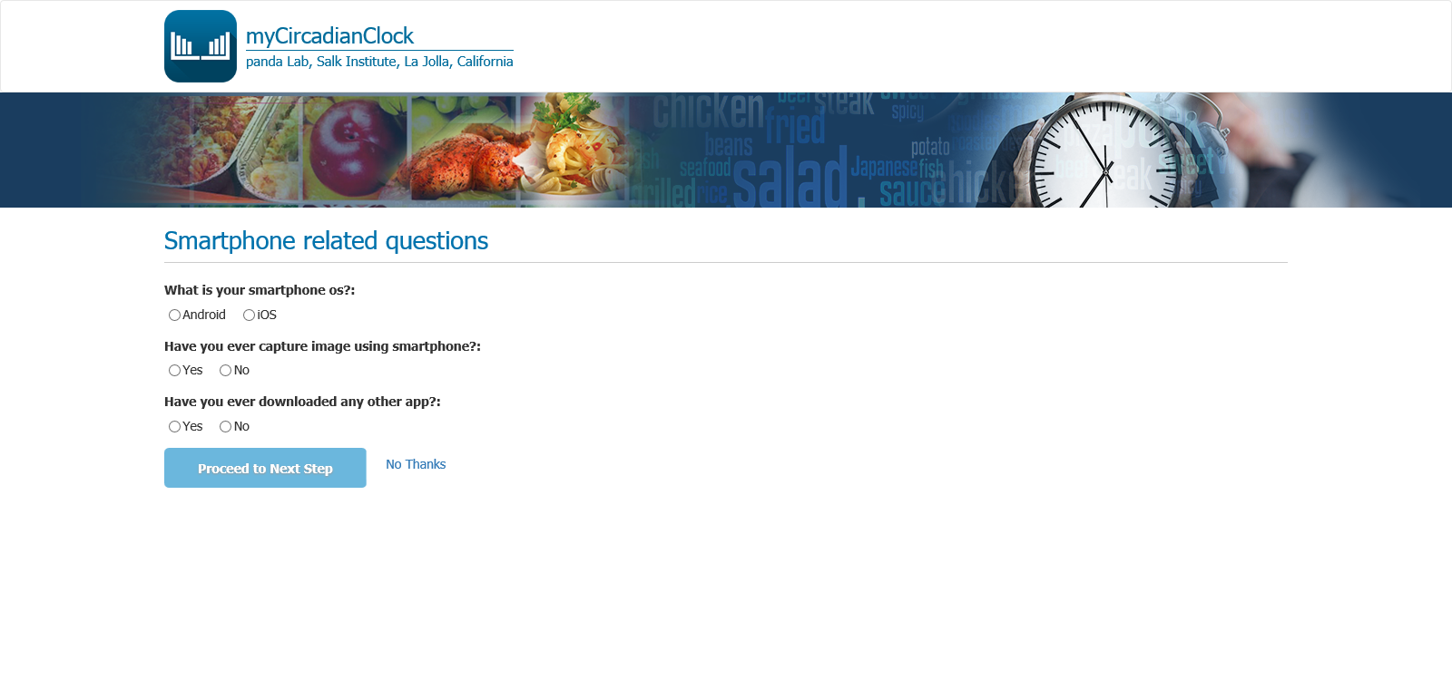
We addressed this slide in person.
But a good title to replace “Smartphone related questions” would be:
How well do you know your phone?

Slide 7
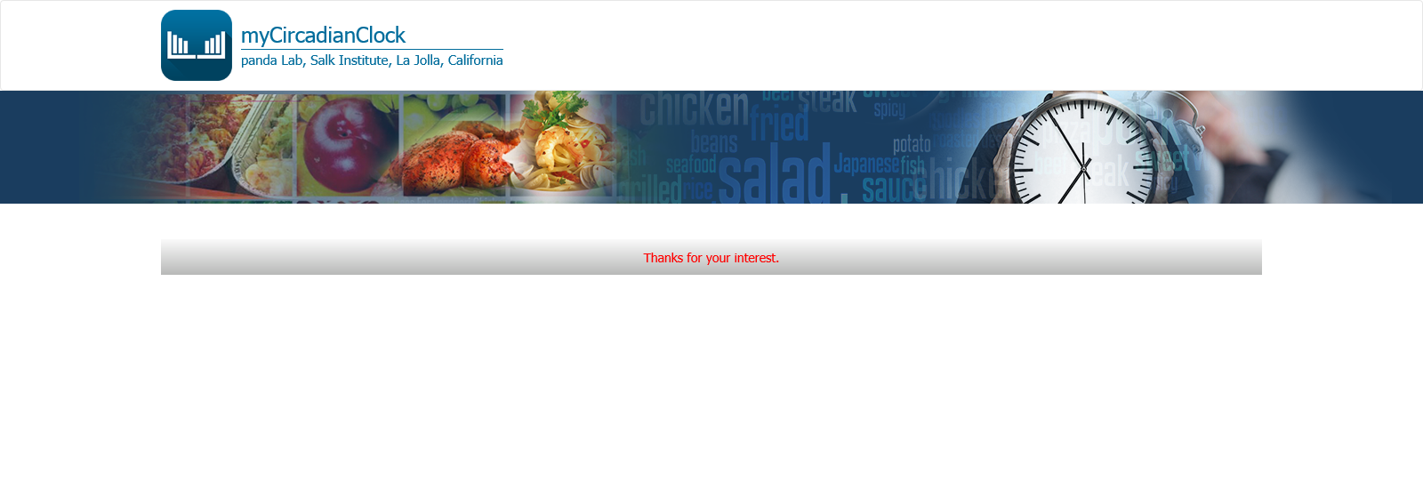

Thank you for your interest .
Thank you for your interest!

Slide 8
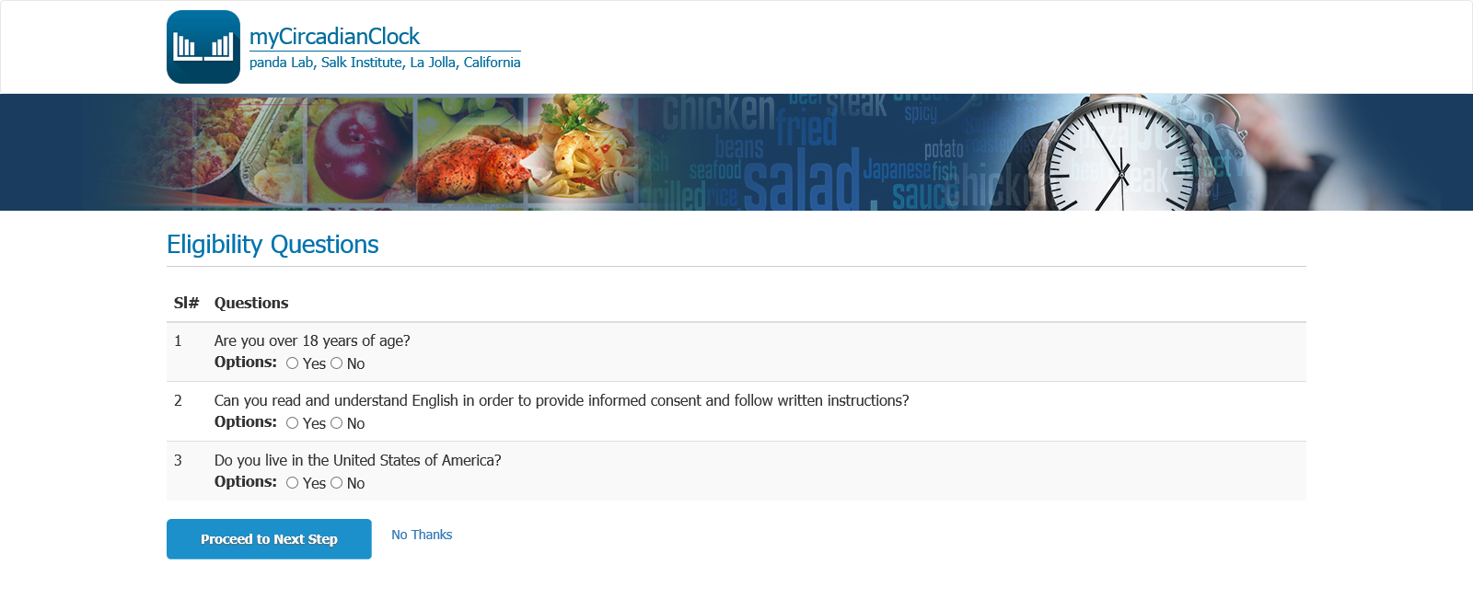
*Get rid of “ SI#” and “Questions”
Are you 18 years of age or older?

Slide 9
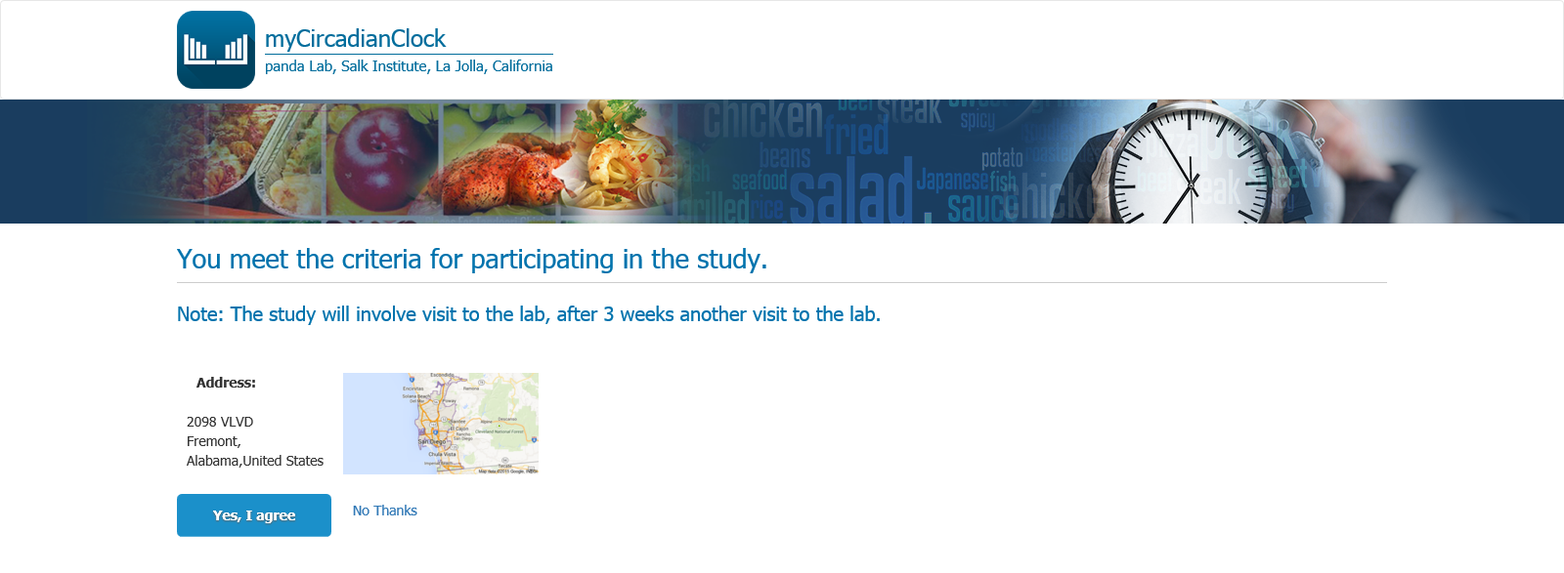
Congratulations! You meet the study criteria for participation.
Please click the button below to continue with Informed Consent.
Button = “Yes, I would like to participate.”
Note: The study will involve visit to the lab, after 3 weeks another visit to the lab.
*Delete address and map.

Slide 10
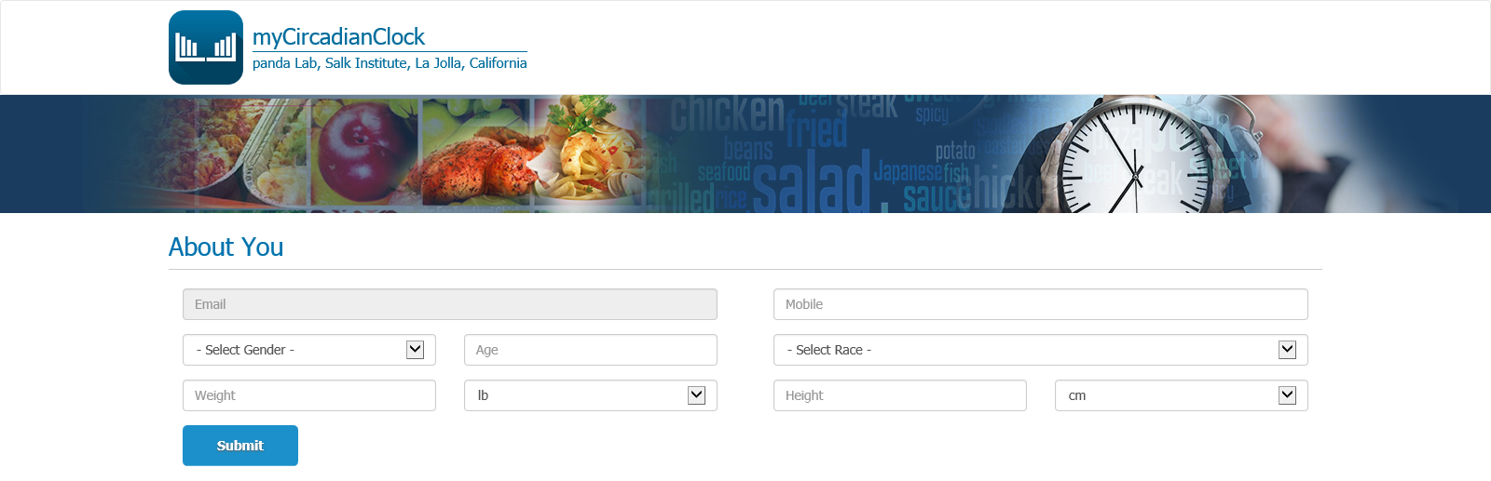
Tell Us About Yourself!
*Remove Email (per convo in your office it is to be moved to IC).
*Remove “Gender” and replace with “Sex” – Male or Female
*Remove “Race” and replace with “Race and Ethnicity”: white; black or African American; American Indian and Alaskan Native; Asian; Native Hawaiian and Other Pacific Islander; Hispanic or Latino; two or more races *These are in accordance with the most recent US Census (so if you want to compare any data to US stats during analysis, following this may prove beneficial.) THESE ARE ALREADY IN DROP DOWN BOX.
Add pull-down menu of feet and inches and Remove cm.
When talking you said you desired a capture at end here with a print option added.
Add Education level
Add Annual Income
Add Shift Worker (work full time on evening shift, night shift, rotating shifts, or other employer arranged irregular schedules – from CDC: http://www.cdc.gov/niosh/topics/workschedules/ * Direct wording so likely have to quote CDC?

